Slide 1

SECD2523 DATABASE
TOPIC 3 | RELATIONAL ALGEBRA
Content adapted from Connolly, T., Begg, C., 2015. Database Systems: A Practical Approach to Design, Implementation, and Management, Global Edition. Pearson Education.

Slide 2
LECTURE LEARNING OUTCOME
By the end of this lecture, students should be able to:
01
Identify relational algebra operations in relational algebra
02
Construct relational algebra statement to query relational database

Slide 3
01
INTRODUCTION
02
RELATIONAL ALGEBRA OPERATIONS I
Selection
Projection
Union
Set Difference
Intersection
Cartesian Product
03
RELATIONAL ALGEBRA OPERATIONS II
Theta Join
Equijoin
Natural Join
Outer Join
Semijoin
04
RELATIONAL ALGEBRA OPERATIONS III
Division
Aggregate Operations
Grouping Operation

Slide 4
INTRODUCTION
Data model tells us the structure of data – requires way to query the data and to modify the data
We need to understand the operations done on relations
RELATIONAL ALGEBRA – a special algebra that consists of some simple but powerful ways to construct new relations from given relations
When the given relations are stored data, then the constructed relation can be answers to queries about this data

Slide 5
INTRODUCTION
Algebra expression– consists of operators and atomic operands
In algebra of arithmetic, atomic operands are variables like x and constants like 15
Operators are + - / * (examples)
An algebra expressions : (x + y) * z

Slide 6
INTRODUCTION
Relational algebra – just like normal algebra that consists of operators and atomic operands
Atomic operands are:
Variables that stand for relations
Constants, which are finite relations
Operations classes:
Set operations
Operations that remove parts of a relation
Operations that combine tuples of 2 relations

Slide 7
INTRODUCTION
Relational algebra operations work on one or more relations to define another relation without changing the original relations.
Both operands and results are relations, so output from one operation can become input to another operation.
Allows expressions to be nested (i.e. relations are closed under the algebra) - This property is called closure.

Slide 8
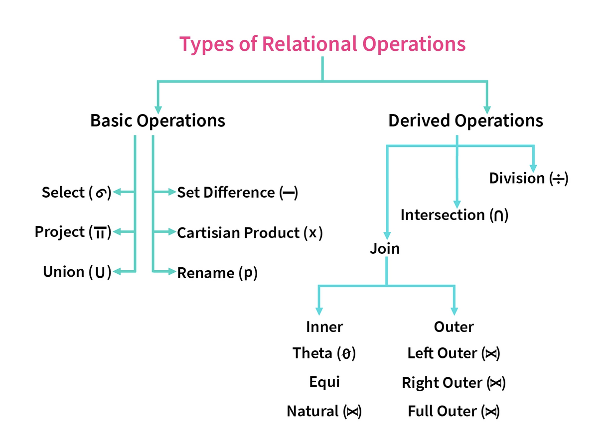
RELATIONAL ALGEBRA
Five basic operations in relational algebra: Selection, Projection, Cartesian Product, Union, and Set Difference.
These perform most of the data retrieval operations needed.
Also have Join, Intersection, and Division operations, which can also be expressed in terms of 5 basic operations.
Selection and Projection are unary operations – operate on one relation
others are binary operations – requires pairs of relations

Slide 9
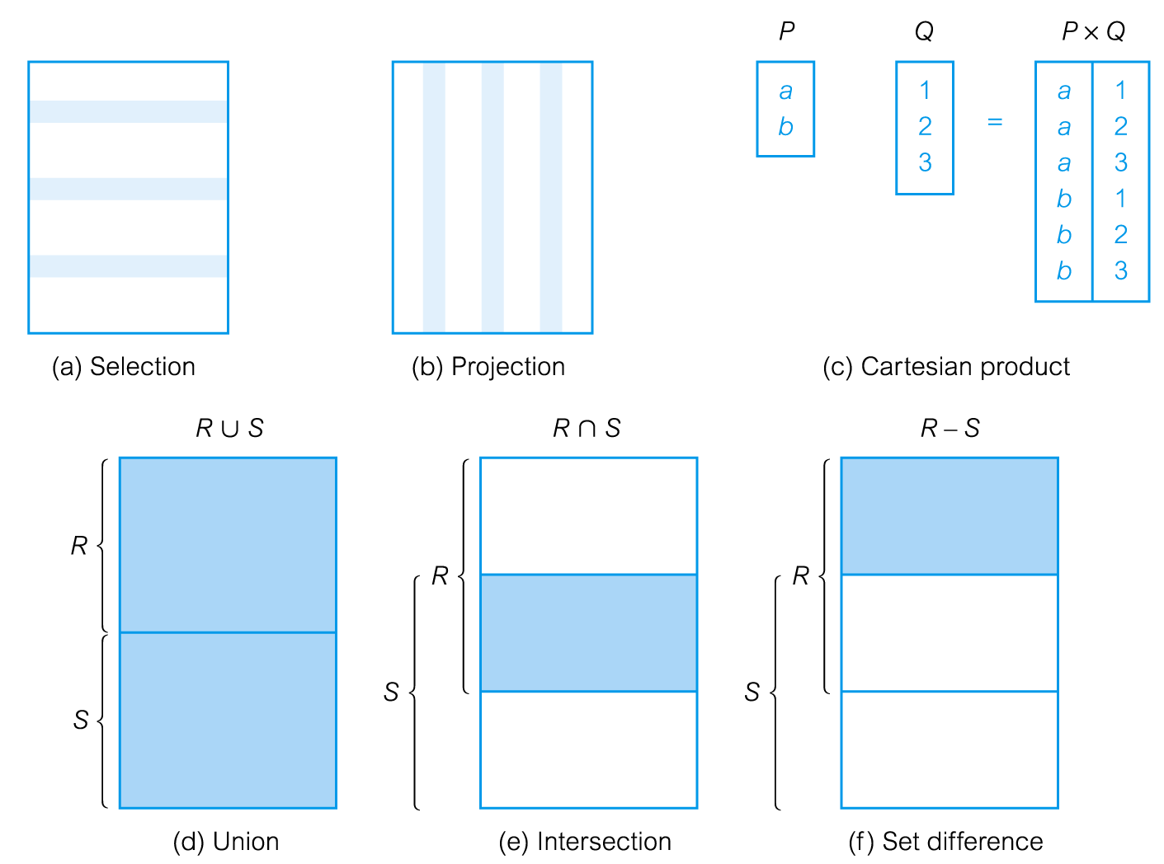
RELATIONAL ALGEBRA

Slide 10
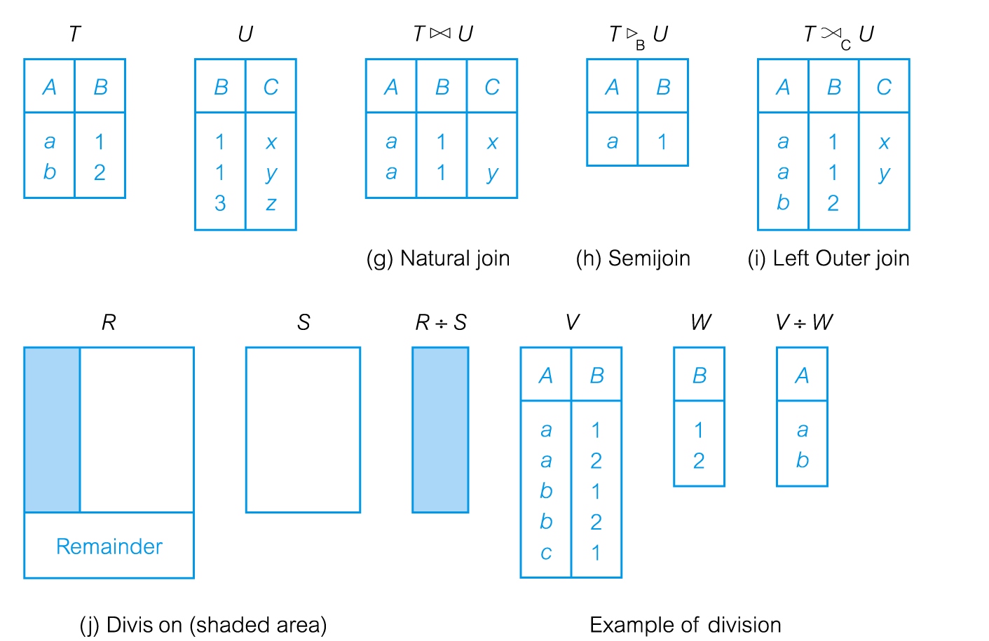
RELATIONAL ALGEBRA

Slide 11
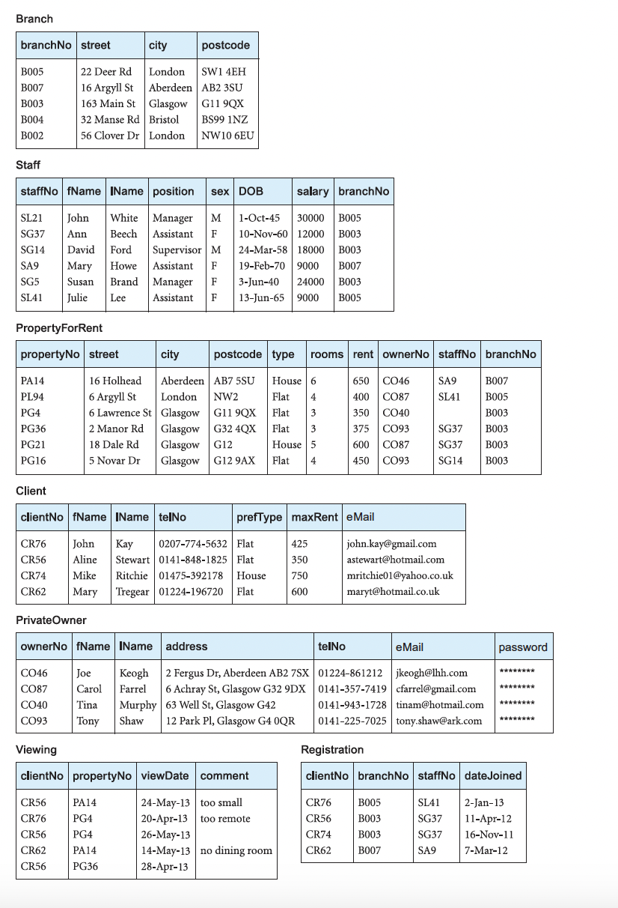
We will use example in Database Systems 6th Ed. (Connolly & Begg, 2016).
Figure 4.3 from Chapter 4 The Relational Model (page 160)

Slide 12
RELATIONAL ALGEBRA OPERATION I

Slide 13
SELECTION (σ)
σ_{predicate} (R)
RELATIONAL ALGEBRA OPERATION I
Works on a single relation R
Defines a relation that contains only those tuples (rows) of R that satisfy the specified condition (predicate).

Slide 14
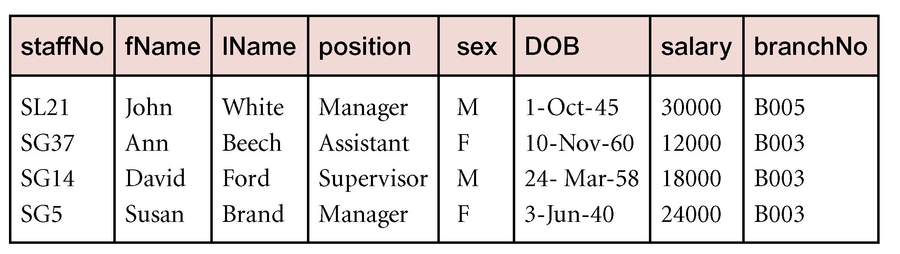
SELECTION (σ)
List all staff with a salary greater than £10,000.
σ_{salary > 10000} (Staff)
RELATIONAL ALGEBRA OPERATION I

Slide 15
PROJECTION ( Π )
Πcol₁, . . . , col_{n}(R)
RELATIONAL ALGEBRA OPERATION I
Works on a single relation R
Defines a relation that contains a vertical subset of R
Extracts the values of specified attributes and eliminating duplicates.

Slide 16
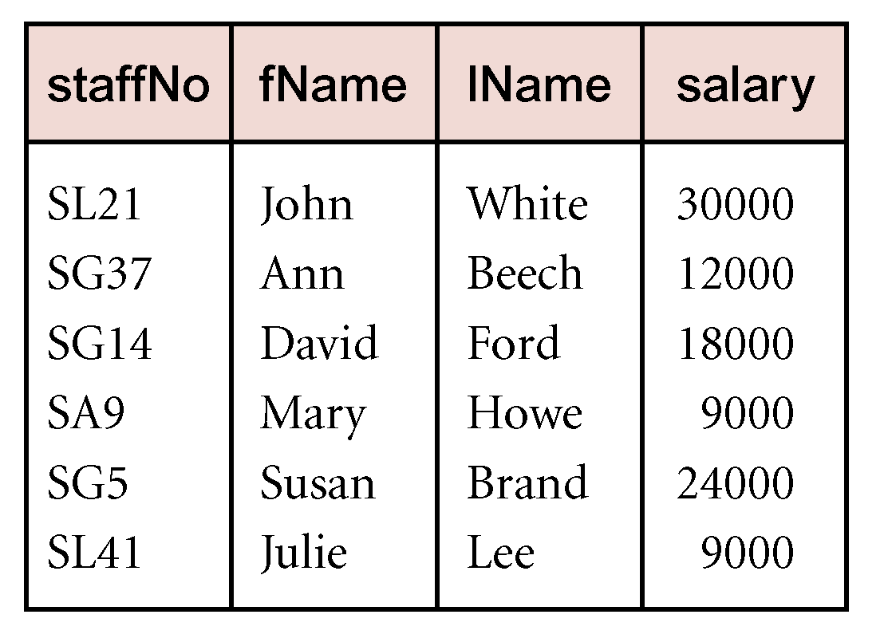
PROJECTION ( Π )
Produce a list of salaries for all staff, showing only staffNo, fName, lName, and salary details.
Π_{staffNo, fName, lName, salary}(Staff)
RELATIONAL ALGEBRA OPERATION I

Slide 17
UNION ( ∪ )
R ∪ S
Union of two relations R and S defines a relation that contains all the tuples of R, or S, or both R and S, duplicate tuples being eliminated.
R and S must be union-compatible.
Degree of relation R and S is the same
Domain for each pair of attribute in R and S is the same
R(A1, A2, A3... An) ; S(B1, B2, B3.... Bn) → domain(Ai) = domain (Bi) for 1<=i<=n
If R and S have i and j tuples, respectively, union is obtained by concatenating them into one relation with a maximum of (i + j) tuples.
RELATIONAL ALGEBRA OPERATION I

Slide 18
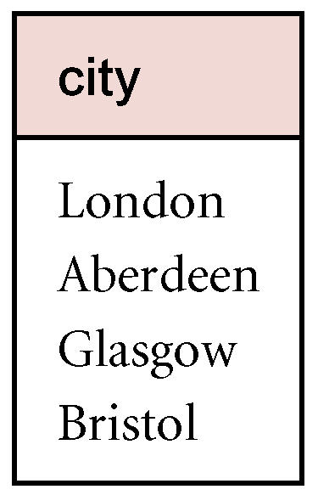
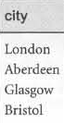
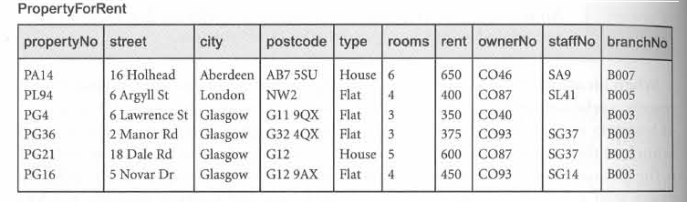
UNION ( ∪ )
List all cities where there is either a branch office or a property for rent.
Π_{city}(Branch) ∪ Π_{city}(PropertyForRent)
RELATIONAL ALGEBRA OPERATION I
∪
=

Slide 19
SET DIFFERENCE ( – )
R – S
RELATIONAL ALGEBRA OPERATION I
Defines a relation consisting of the tuples that are in relation R, but not in S.
R and S must be union-compatible.

Slide 20
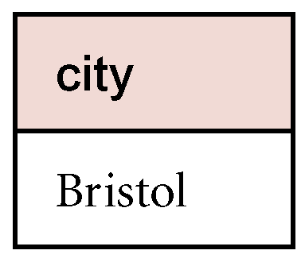
SET DIFFERENCE ( – )
List all cities where there is a branch office but no properties for rent.
Π_{city}(Branch) – Π_{city}(PropertyForRent)
RELATIONAL ALGEBRA OPERATION I
-
=

Slide 21
INTERSECTION ( ∩ )
R ∩ S
RELATIONAL ALGEBRA OPERATION I
Defines a relation consisting of the set of all tuples that are in both R and S.
R and S must be union-compatible.
Expressed using basic operations:
R ∩ S = R – (R – S)

Slide 22
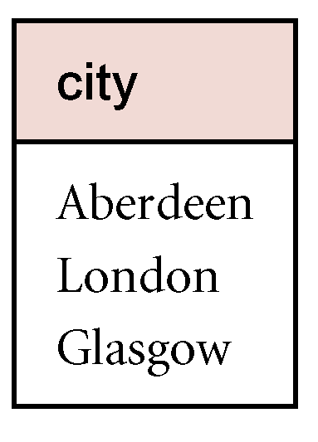
INTERSECTION ( ∩ )
List all cities where there is both a branch office and at least one property for rent.
Π_{city}(Branch) ∩ Π_{city}(PropertyForRent)
RELATIONAL ALGEBRA OPERATION I
∩
=

Slide 23
CARTESIAN PRODUCT ( X )
R X S
RELATIONAL ALGEBRA OPERATION I
Defines a relation that is the concatenation of every tuple of relation R with every tuple of relation S.

Slide 24
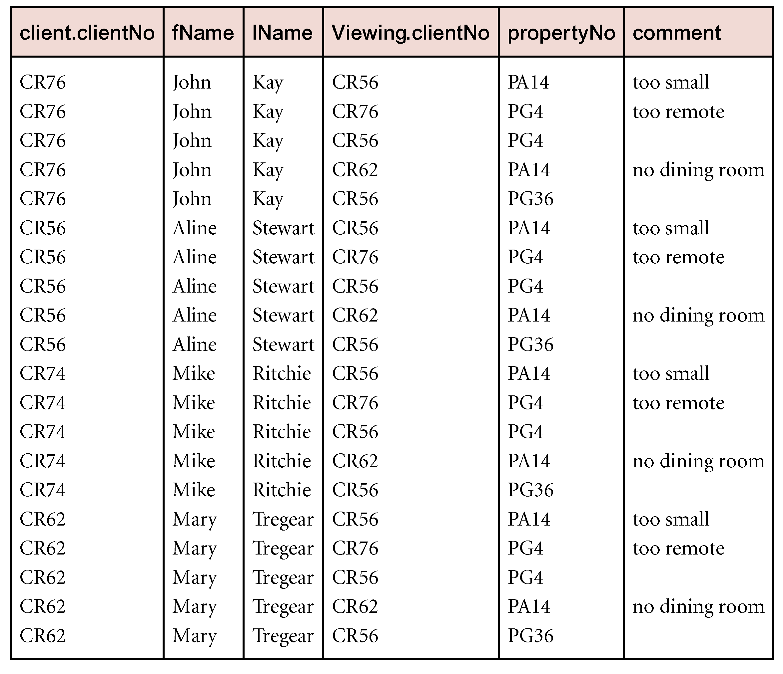
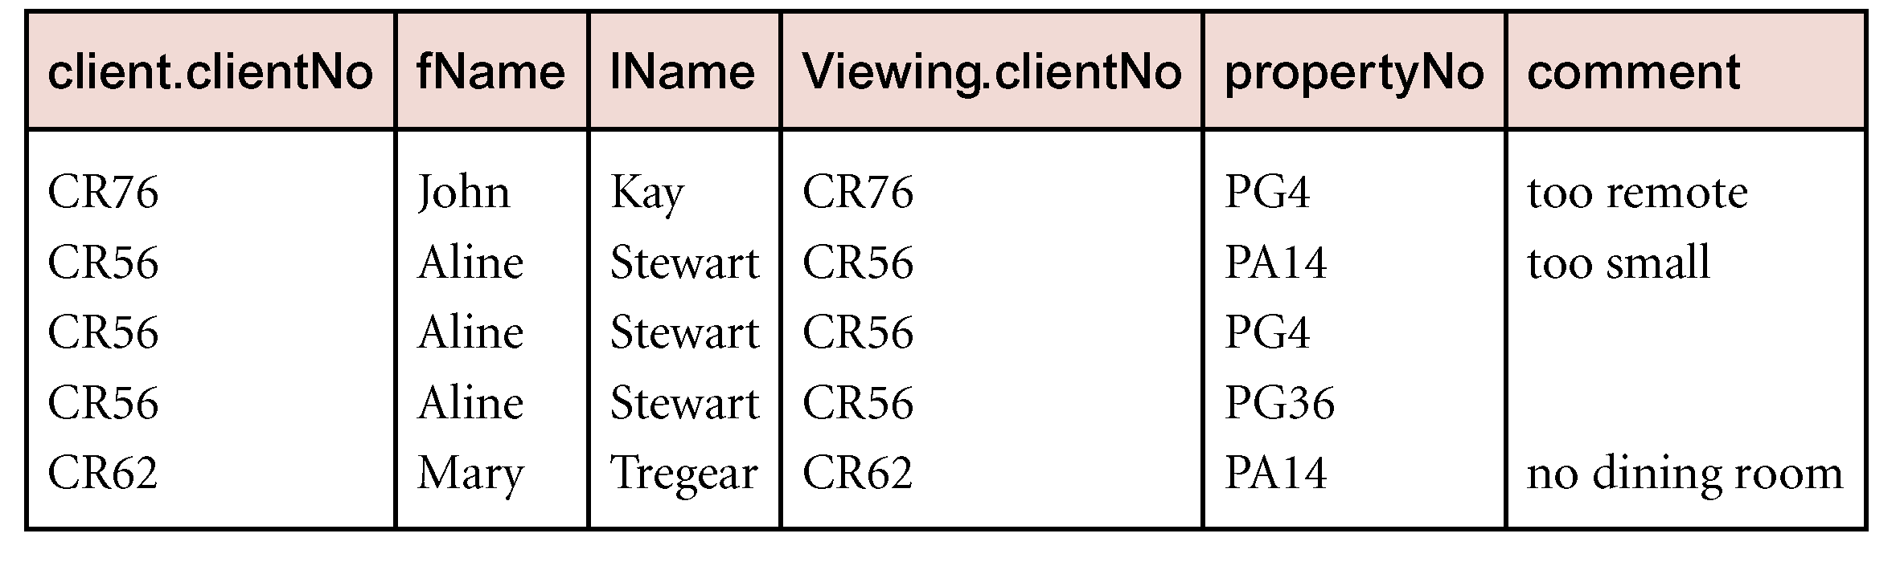

CARTESIAN PRODUCT ( X )
List the names and comments of all clients who have viewed a property for rent.
σClient.clientNo = Viewing.clientNo((∏_{clientNo, fName, lName}(Client)) Χ (∏_{clientNo, propertyNo, comment}(Viewing)))
1. Use selection operation to extract those tuples where Client.clientNo = Viewing.clientNo.
2. Use Cartesian Product (X) and Project selected column
RELATIONAL ALGEBRA OPERATION I
Cartesian Product and Selection can be reduced to a single operation called a Join.

Slide 25
CARTESIAN PRODUCT ( X )
Use selection operation to extract those tuples where Client.clientNo = Viewing.clientNo.
RELATIONAL ALGEBRA OPERATION I
Cartesian product and Selection can be reduced to a single operation called a Join.

Slide 26
CLASS DISCUSSION I
Describe the result of the relational algebra expression:
ΠhotelNo (σprice > 50 (Room) )
σ Hotel.hotelNo = Room.hotelNo(Hotel X Room)
RELATIONAL ALGEBRA OPERATION I

Slide 27
CLASS DISCUSSION I
Write the relational algebra expression for the following statements:
List all hotels.
List all single rooms with a price below RM200 per night.
List the names and cities of all guests.
RELATIONAL ALGEBRA OPERATION I

Slide 28
RELATIONAL ALGEBRA II

Slide 29
JOIN OPERATIONS
Join is a derivative of Cartesian product.
Equivalent to performing a Selection, using join predicate as selection formula, over Cartesian product of the two operand relations.
One of the most difficult operations to implement efficiently in an RDBMS and one reason why RDBMSs have intrinsic performance problems.
Various forms of join operation
Theta join
Equijoin (a particular type of Theta join)
Natural join
Outer join
Semijoin
RELATIONAL ALGEBRA OPERATION II

Slide 30
THETA JOIN (θ-JOIN)
R _{F} S
Defines a relation that contains tuples satisfying the predicate F from the Cartesian product of R and S.
The predicate F is of the form R.a_{i} θ S.b_{i} where θ may be one of the comparison operators (<, ≤, >, ≥, =, ≠).
RELATIONAL ALGEBRA OPERATION II

Slide 31
THETA JOIN (θ-JOIN)
Can rewrite Theta join using basic Selection and Cartesian product operations.
R _{F}S = σ_{F}(R Χ S)
RELATIONAL ALGEBRA OPERATION II
Degree of a Theta join is sum of degrees of the operand relations R and S.
Example:
List the names of clients with the apartment they can afford.
TempClient ⋈TempClient.maxRent ≤ TempPropertyForRent.rent TempPropertyForRent

Slide 32
EQUIJOIN
If predicate F contains only equality (=), the term Equijoin is used.
Example:
List the names and comments of all clients who have viewed a property for rent.
RELATIONAL ALGEBRA OPERATION II
(Π_{clientNo, fName, lName}(Client)) Client.clientNo = Viewing.clientNo (Π_{clientNo, propertyNo, comment}(Viewing))

Slide 33
NATURAL JOIN
R S
An Equijoin of the two relations R and S over all common attributes x.
One occurrence of each common attribute is eliminated from the result.
RELATIONAL ALGEBRA OPERATION II

Slide 34
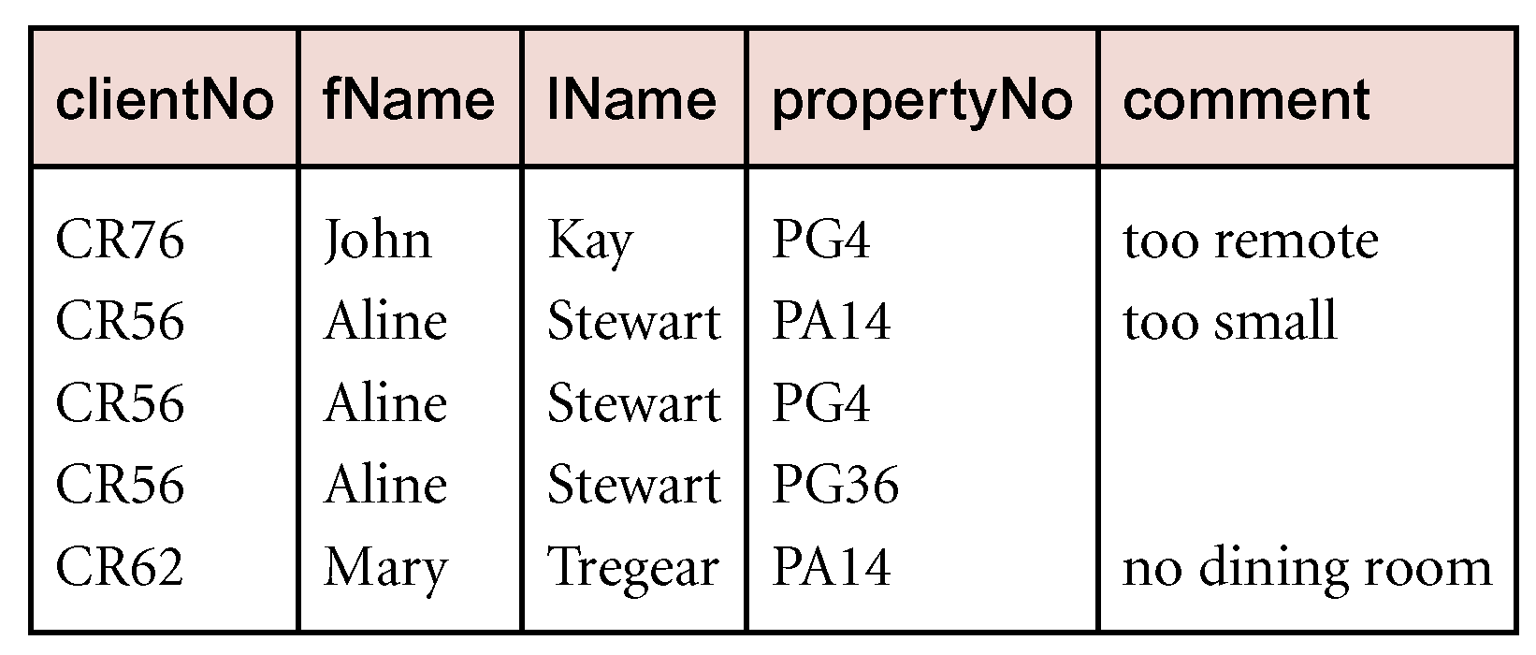
NATURAL JOIN
List the names and comments of all clients who have viewed a property for rent.
(Π_{clientNo, fName, lName}(Client)) (Π_{clientNo, propertyNo, comment}(Viewing))
RELATIONAL ALGEBRA OPERATION II

Slide 35
OUTER JOIN ( )
R S
To display rows in the result that do not have matching values in the join column, use OUTER JOIN.
(Left) outer join is a join in which tuples from R that do not have matching values in common columns of S are also included in result relation.
RELATIONAL ALGEBRA OPERATION II

Slide 36
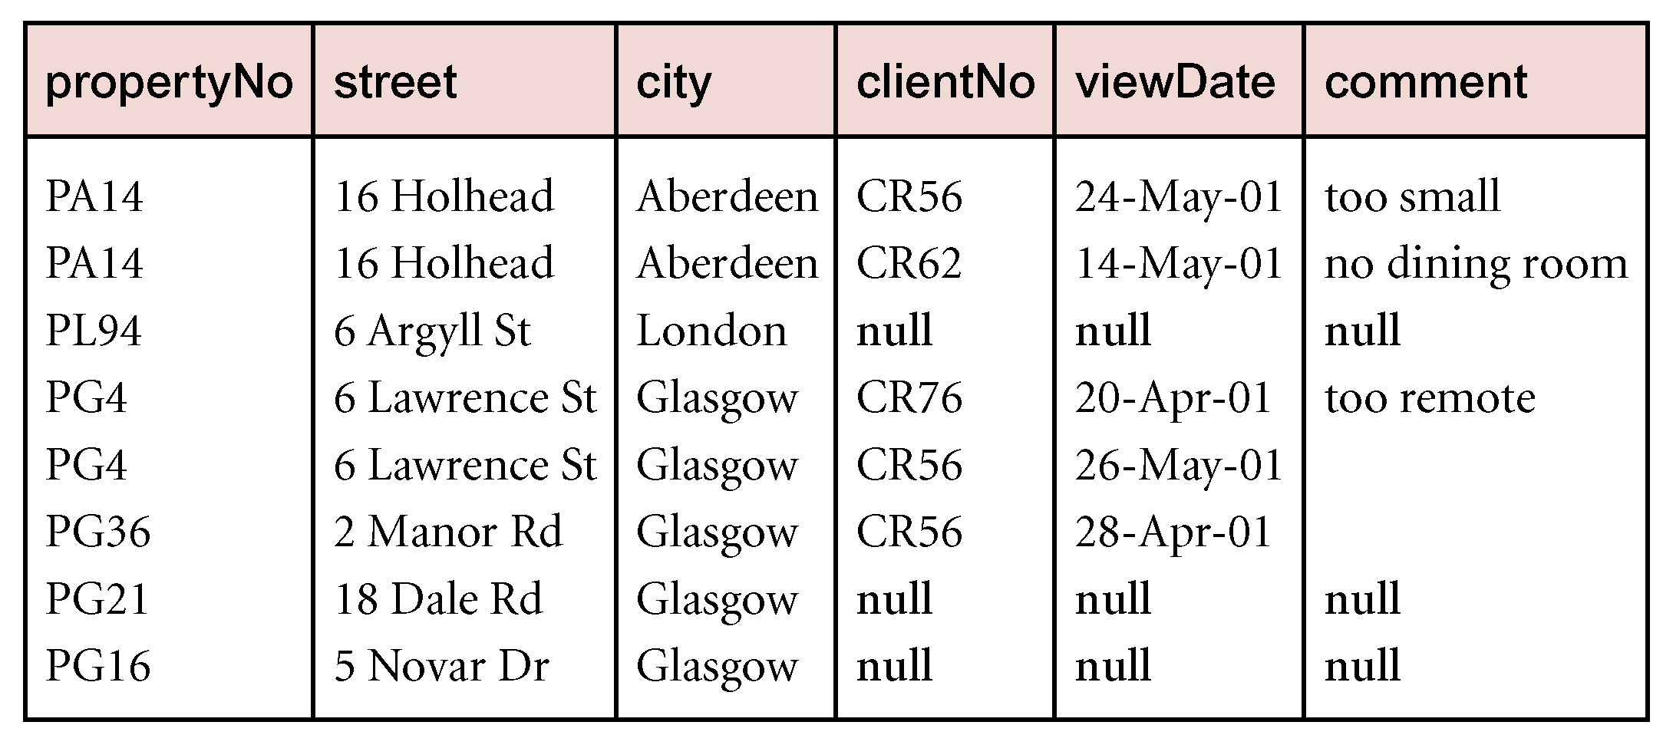
OUTER JOIN ( )
Produce a status report on property viewings.
Π_{propertyNo, street, city}(PropertyForRent) Viewing
RELATIONAL ALGEBRA OPERATION II

Slide 37
SEMIJOIN ( )
R S
Can rewrite Semijoin using Projection and Join:
RELATIONAL ALGEBRA OPERATION II
R _{F} S = Π_{A}(R _{F} S)
Defines a relation that contains the tuples of R that participate in the join of R with S.

Slide 38
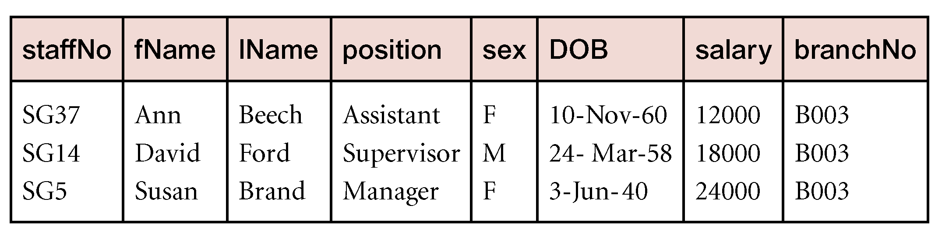
SEMIJOIN ( )
List complete details of all staff who work at the branch in Glasgow.
Staff _{Staff.branchNo=Branch.branchNo}(σ_{city=‘Glasgow’}(Branch))
RELATIONAL ALGEBRA OPERATION II

Slide 39
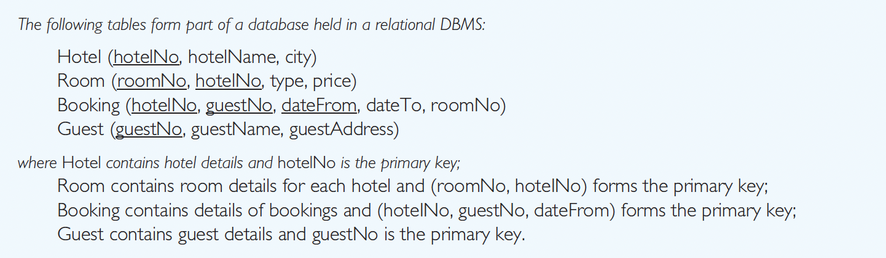
CLASS DISCUSSION II
Describe the result of the relational algebra expression based on the following schema:
RELATIONAL ALGEBRA OPERATION II
ΠhotelName (Hotel Hotel.hotelNo = Room.hotelNo (σ price > 50 (Room)) )
Guest ( σdateTo ≥ ‘1-Jan-2002’ (Booking))
Hotel Hotel.hotelNo = Room.hotelNo (σ price > 50 (Room)) )
ΠguestName, hotelNo (Booking Booking.guestNo = Guest.guestNo Guest) ÷ ΠhotelNo (σ city = ’London’(Hotel))

Slide 40
CLASS DISCUSSION II
2. Guest ( σdateTo ≥ ‘1-Jan-2002’ (Booking))
This will produce a (left outer) join of Guest and those tuples of Booking with an end date (dateTo) greater than or equal to 1-Jan-2002.
All guests who don’t have a booking with such a date will still be included in the join.
Essentially this will produce a relation containing all guests and show the details of any bookings they have beyond 1-Jan-2002.
RELATIONAL ALGEBRA OPERATION II

Slide 41
CLASS DISCUSSION II
Write the relational algebra expression for the following statements (refer to the Hotel schema in previous question):
List the price and type of all rooms at the Grosvenor Hotel.
List all guests currently staying at the Grosvenor Hotel.
List the details of all rooms at the Grosvenor Hotel, including the name of the guest staying in the room, if the room is occupied.
List the guest details (guestNo, guestName, and guestAddress) of all guests staying at the Grosvenor Hotel.
RELATIONAL ALGEBRA OPERATION II

Slide 42
RELATIONAL ALGEBRA III

Slide 43
DIVISION ( ÷ )
R ÷ S
Defines a relation over the attributes C that consists of set of tuples from R that match combination of every tuple in S.
Expressed using basic operations:
T₁ ← Π_{C}(R)
T₂ ← Π_{C}((S X T₁) – R)
T ← T₁ – T₂
RELATIONAL ALGEBRA OPERATION III

Slide 44
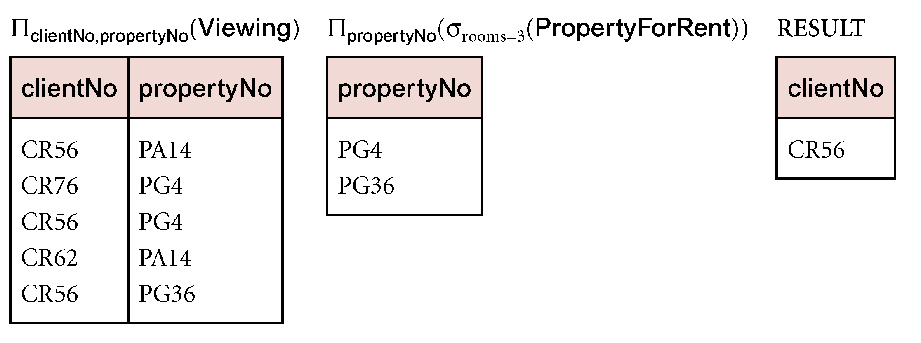
DIVISION ( ÷ )
Identify all clients who have viewed all properties with three rooms.
(Π_{clientNo, propertyNo}(Viewing)) ÷ (Π_{propertyNo}(σ_{rooms = 3} (PropertyForRent)))
RELATIONAL ALGEBRA OPERATION III
÷

Slide 45
AGGREGATE OPERATIONS
ℑAL(R)
Applies aggregate function list, AL, to R to define a relation over the aggregate list.
AL contains one or more (<aggregate_function>, <attribute>) pairs.
Main aggregate functions are : COUNT, SUM, AVG, MIN, and MAX.
RELATIONAL ALGEBRA OPERATION III

Slide 46
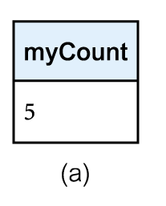
AGGREGATE OPERATIONS
How many properties cost more than $350 per month to rent?
ρ_{R}(myCount) ℑ_{COUNT} _{propertyNo} (σ_{rent > 350} (PropertyForRent))
Rename operation ~rho
RELATIONAL ALGEBRA OPERATION III
count

Slide 47
AGGREGATE OPERATIONS
GAℑAL(R)
Groups tuples of R by grouping attributes (GA), and then applies aggregate function list (AL), to define a new relation.
AL contains one or more (<aggregate_function>, <attribute>) pairs.
Resulting relation contains the grouping attributes, GA, along with results of each of the aggregate functions.
RELATIONAL ALGEBRA OPERATION III

Slide 48
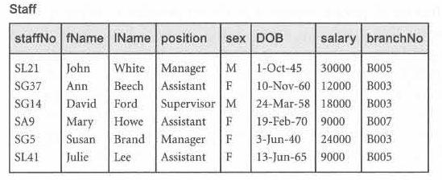
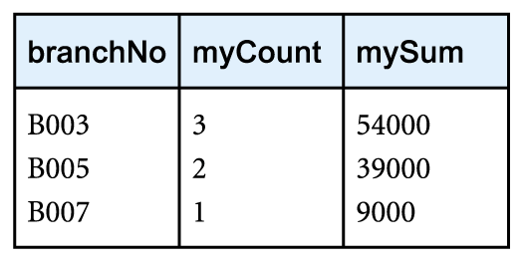
AGGREGATE OPERATIONS
Find the number of staff working in each branch and the sum of their salaries.
ρ_{R}(branchNo, myCount, mySum) _{branchNo} ℑ _{COUNT staffNo,} _{SUM salary} (Staff)
RELATIONAL ALGEBRA OPERATION III

Slide 49
CLASS DISCUSSION III
Describe the result of the relational algebra expression
ΠguestName, hotelNo (Booking Booking.guestNo = Guest.guestNo Guest) ÷ ΠhotelNo (σ city = ’London’(Hotel))
RELATIONAL ALGEBRA OPERATION III

Slide 50
SUMMARY
The relational algebra is a (high-level) procedural language: it can be used to tell the DBMS how to build a new relation from one or more relations in the database.
The five fundamental operations in relational algebra [Selection, Projection, Cartesian product, Union, and Set difference] perform most of the data retrieval operations that we are interested in.
In addition, there are also the Join, Intersection, and Division operations, which can be expressed in terms of the five basic operations.
RELATIONAL ALGEBRA OPERATION III

Slide 51


